Slide 1
Circuit Theory & Analysis
Power Factor Correction

Slide 2
Three Phase Circuits
Real Power, Reactive Power , Apparent Power and Power Factor Correction
Circuit Theory & Analysis

Slide 3
Objectives
  Define real, reactive, apparent power and system power factor
  Derive the relationship for real, reactive, apparent power and system power factor for various types of three phase loads.
  Importance and the need for power factor correction by solving problems
Circuit Theory & Analysis
Notes:
Student should be able to:
Define real, reactive, apparent power and system power factor
Derive relationship for real, reactive, apparent power and system power factor and draw power triangle
Solve problems on power factor correction.

Slide 4
Reasons for Power Factor Correction
Most industrial loads consist of electric motors.
Thus they are inductive and they have lagging power factors.
The power factor becomes increasingly important
since the load current, I_{L} = P/(√3 V_{L}cosφ).
Circuit Theory & Analysis

Slide 5
Reasons for Power Factor Correction
Example:
For a supply voltage of 100 V and to supply a power of 10 kW,
Case (a): Unity power factor i.e. cos φ =1
Load current, I_{L} = P/(√3 V_{L}cosφ)
= 10000 /(√3 x 100 x 1)
= 57.74 A
Apparent Power = √3 V_{L} I_{L}
= 10 kVA
Circuit Theory & Analysis

Slide 6
Reasons for Power Factor Correction
Case (b): power factor = 0.67 lag
Load current, I_{L} = P/(√3 V_{L}cos φ)
= 10000/(√3 x 100 x 0.67)
= 86.17 A
Apparent Power = √3 V_{L} I_{L} = 14.93 kVA
Generators and transformers used in power distribution systems are rated in apparent power. At a fixed operating voltage, the loading on the system increases as higher current flow in the distribution lines.
Circuit Theory & Analysis

Slide 7
Reasons for Power Factor Correction
Larger conductors, cables, protection circuits etc are to be used i.e. greater costs of supplying the power.
Circuit Theory & Analysis

Slide 8
True or Active Power
UNITS in watts W, or kW, or MW
V_{PH} and I_{PH} are
rms values
I_{PH}
V_{PH}
⎟ Z ⎟ ∠ φ
Power dissipation across each phase
(or each arm) of a 3-phase load is given by
P_{PH} = V_{PH} I_{PH} cos φ
Total power dissipation of a balanced
3-phase load is given by
P_{T} = 3 x P_{PH} = 3 V_{PH} I_{PH} cos φ = √3 V_{L} I_{L} cos φ
Circuit Theory & Analysis
Notes:
Where V_{PH} is the rms value of the voltage across one phase,
I_{PH} the rms value of the current flowing through the SAME phase, and
cos φ the power factor, with angle φ being the phase angle between the phase voltage across and the phase current through the same phase or the impedance angle.

Slide 9
Reactive Power
UNITS in VAR , or kVAR, or MVAR
V_{PH} and I_{PH} are
rms values
I_{PH}
V_{PH}
⎟ Z ⎟ ∠ φ
Reactive power across each phase
(or each arm) of a 3-phase load is given by
Q_{PH} = V_{PH} I_{PH} sin φ
Total reactive power of a balanced 3-phase
load is given by
Q_{T} = 3 x Q_{PH} = 3 V_{PH} I_{PH} sin φ = √3 V_{L} I_{L} sin φ
Circuit Theory & Analysis

Slide 10
Apparent Power
UNITS in volt-ampere VA, or kVA, or MVA
V_{PH} and I_{PH} are
rms values
I_{PH}
V_{PH}
⎟ Z ⎟ ∠ φ
Apparent power across each phase
(or each arm) of a 3-phase load is given by
S_{PH} = V_{PH} I_{PH}
Total apparent power of a balanced 3-phase load is given by
S_{T} = 3 x S_{PH} = 3 V_{PH} I_{PH} = √3 V_{L} I_{L}
Circuit Theory & Analysis

Slide 11
Power Triangle
For a balanced star or delta load, we have
True power P = √3 V_{L} I_{L} cos φ (W)
Reactive power Q = √3 V_{L} I_{L} sin φ (VAR) and
Apparent power S = √3 V_{L} I_{L} (VA)
P / S = cos φ = power factor of each arm of the load, which is also the power factor of the whole balanced 3-phase load
Circuit Theory & Analysis

Slide 12
Power Triangle
For a balanced star or delta load, we have
True power P = √3 V_{L} I_{L} cos φ (W)
Reactive power Q = √3 V_{L} I_{L} sin φ (VAR) and
Apparent power S = √3 V_{L} I_{L} (VA)
P² + Q² = 3 V_{L}² I_{L}² cos² φ + 3 V_{L}² I_{L}² sin² φ
= 3 V_{L}² I_{L}² ( cos² φ + sin² φ )
= 3 V_{L}² I_{L}²
= S²
Circuit Theory & Analysis

Slide 13
Power Triangle
Now P² + Q² = S² , showing that P, Q and S must form a right-angled triangle (Pythagoras Theorem). This triangle is called the POWER TRIANGLE.
Two types of power triangles for:-
(a) net inductive load, and
(b) net capacitive load
Circuit Theory & Analysis

Slide 14
Power Triangle
Net inductive load
(lagging power factor)
Net capacitive load
(leading power factor)
P
S
Q
Q
S
P
S = P + j Q
S = P - j Q
Circuit Theory & Analysis

Slide 15
Power Triangle
Pure Resistor
Pure Inductor
Pure Capacitor
S = P
S = jQ
S = -jQ
Circuit Theory & Analysis

Slide 16
Example 2.6
A 3-phase, 55.2 kW, 400 V, 50 Hz induction motor operates on full load with an efficiency of 92% and at a power factor (p.f.) of 0.8 lagging. Calculate the total kVA rating of capacitors required to raise the overall full-load power factor to (a) 0.95 lagging and (b) unity.
Circuit Theory & Analysis

Slide 17
Example 2.6
V_{L} = 400 V
55.2 kW
η = 92%
p.f. = 0.8
lagging
I M
Capacitor Bank
Overall p.f. = (a) 0.95 lagging and (b) unity
Circuit Theory & Analysis

Slide 18
Example 2.6
Input power
V_{L} = 400 V
55.2 kW
η = 92%
p.f. = 0.8
lagging
I M
55.2 kW is the output power of the motor.
efficiency = output / input
Input power P = output / efficiency
= 55.2k / 0.92
= 60 kW
Circuit Theory & Analysis

Slide 19
Example 2.6
B
Power triangle ABC of the motor alone.
p.f. = cos φ₁ = 0.8 lagging
φ₁ = cos⁻¹ 0.8 = 36.87°
Q
φ₁
C
A
P
Q = P tan φ₁ = 60k tan 36.87° = 45 kVAR
Q here is considered to be positive for loads of lagging power factor.
Circuit Theory & Analysis

Slide 20
Example 2.6
B
(a)
Q
P = 60 kW
Q = 45 kVAR
φ₁
C
A
P
Q_{C}
The addition of the capacitors contributes an amount of Q_{C} ( kVAR ) into the system.
Q_{C} for capacitors is considered as negative.
Circuit Theory & Analysis
Notes:
The length of Q_{C} depends on the overall power factor.

Slide 21
Example 2.6
B
(a)
Q
P = 60 kW
Q = 45 kVAR
D
φ₁
φ₂
C
A
Overall p.f. = 0.95 = cos φ₂
φ₂ = cos⁻¹ 0.95 = 18.19°
P
Q_{C}
Combine the power triangle ABC of the motor with the Q_{C} from the capacitors to form the overall power triangle of the overall load (including the motor and the capacitors)
Circuit Theory & Analysis
Notes:
Overall power triangle should point up because the overall power factor is given as 0.95 lagging.

Slide 22
Example 2.6
B
(a)
Q
P = 60 kW
Q = 45 kVAR
D
φ₁
φ₂
C
A
P
Q_{C}
ADC is now the power triangle of the overall load.
We do not know the value of Q_{C} (length of BD), but we know φ₂ = cos⁻¹ 0.95 = 18.19°
Circuit Theory & Analysis

Slide 23
Example 2.6
(a)
Q
D
φ₁
P = 60 kW
Q = 45 kVAR
Q - Q_{C}
φ₂
C
A
P
Q_{C}
Length DC = Q - Q_{C} = P tan φ₂ = 60k x tan 18.19°
= 19.68 kVAR
Q_{C} = Q - 19.68 = 45k - 19.68 k = 25.32 kVAR
= S_{C} =25.32 kVA
Circuit Theory & Analysis

Slide 24
Example 2.6
Input power
(b)
V_{L} = 400 V
55.2 kW
η = 92%
p.f. = 0.8
lagging
I M
55.2 kW is the output power of the motor.
efficiency = output / input
Input power P = output / efficiency
= 55.2k / 0.92
= 60 kW
Circuit Theory & Analysis
Notes:
No change to this calculation

Slide 25
Example 2.6
B
(b)
Power triangle ABC of the motor alone.
p.f. = cos φ₁ = 0.8 lagging
φ₁ = cos⁻¹ 0.8 = 36.87°
Q
φ₁
C
A
P
Q = P tan φ₁ = 60 tan 36.87° = 45 kVAR
Circuit Theory & Analysis
Notes:
No change to this calculation

Slide 26
Example2.6
B
(b)
Q
P = 60 kW
Q = 45 kVAR
φ₁
C
A
P
The addition of the capacitors contributes an amount of Q_{C} ( kVAR ) into the system.
Q_{C} for capacitors is considered as negative.
Circuit Theory & Analysis
Notes:
The length of Q_{C} depends on the overall power factor.

Slide 27
Example 2.6
B
(b)
Q
P = 60 kW
Q = 45 kVAR
φ₁
C
A
Overall p.f. = 1 = cos φ₂
φ₂ = cos⁻¹ 1 = 0°
P
Q_{C}
Circuit Theory & Analysis
Notes:
The length of Q_{C} depends on the overall power factor.
Overall power triangle should be at 0 degree.

Slide 28
Example 2.6
B
(b)
P = 60 kW
Q = 45 kVAR
Q
φ₁
Combine the power triangle ABC of the motor with the Q_{C} from the capacitors to form the overall power triangle of the overall load.
C
A
P
Q_{C}
Circuit Theory & Analysis

Slide 29
Example 2.6
B
(b)
P = 60 kW
Q = 45 kVAR
Q
φ₁
AC is now the power triangle of the overall load.
C
A
P
Q_{C}
The net reactive power consumption for both the motor and capacitors is 0.
Q_{C} = Q = 45kVAR
= S_{C} =45 kVA
Circuit Theory & Analysis

Slide 30
Example 2.7
A 3-φ load takes 150 kW at 400 V, 50 Hz operating at power factor of 0.8 lagging. Determine the kVA rating of a capacitor bank to improve the power factor to 0.88 lagging. What capacitance per phase is required if the capacitor bank is connected (a) in delta and (b) in star?
Circuit Theory & Analysis

Slide 31
Example 2.7
B
Power triangle ABC of the load.
p.f. = cos φ₁ = 0.8 lagging
φ₁ = cos⁻¹ 0.8 = 36.87°
Q₁
φ₁
C
A
P₁
P₁ = 150 kW
Q₁ = P₁ tan φ₁ = 150k tan 36.87° = 112.5 kVAR
Circuit Theory & Analysis

Slide 32
Example 2.7
B
P₁ = 150 kW
Q₁ = 112.5 kVAR
Q₁
D
φ₁
Overall p.f. = 0.88 = cos φ₂
φ₂ = cos⁻¹ 0.88 = 28.36°
φ₂
C
A
P₁
Q_{C}
The addition of the capacitors contributes an amount of Q_{C} ( kVAR ) into the system.
ADC is now the power triangle of the overall load.
Circuit Theory & Analysis
Notes:
The length of Q_{C} depends on the overall power factor.
Overall power triangle should point up because the overall power factor is given as 0.88 lagging.

Slide 33
Example 2.7
Q₁
P₁ = 150 kW
Q₁ = 112.5 kVAR
D
φ₁
Q₁ - Q_{C}
φ₂
C
A
P
Q_{C}
Length DC = Q₁ - Q_{C} = P₁ tan φ₂ = 150k x tan 28.36°
= 80.8 kVAR
Q_{C} = Q₁ - 80.8k = 112.5k – 80.8 k = 31.7 kVAR
= S_{C} = 31.7 kVA
Circuit Theory & Analysis

Slide 34
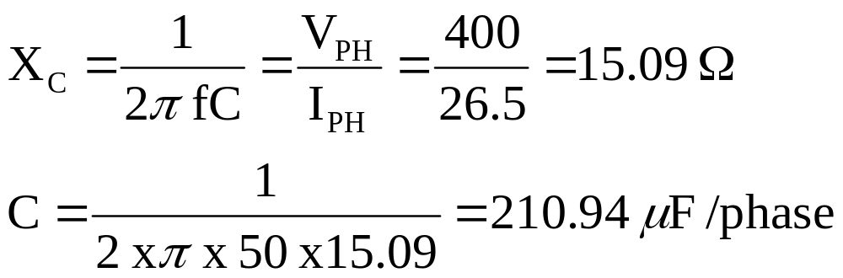
Example 2.7
Therefore the total kVA of the capacitor bank S_{C}
= 31.7 kVA (for 3 phases)
= 10.6 kVA (per phase) = V_{PH} I_{PH}
Capacitor bank in delta
Phase voltage of capacitor bank = line voltage = 400 V
I_{PH} = (10.6 x 10³ )/400 = 26.5 A
Circuit Theory & Analysis

Slide 35
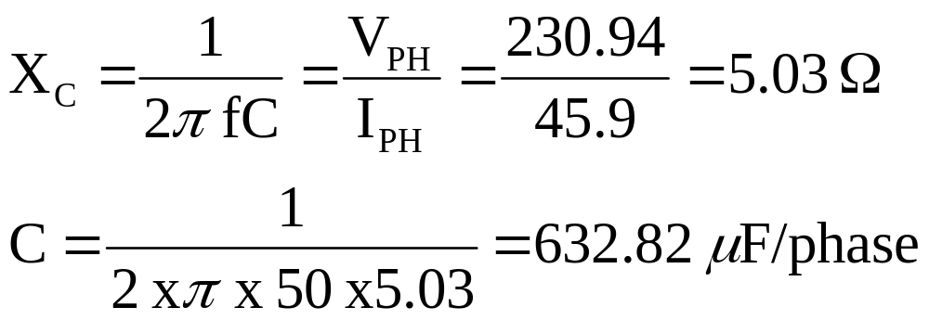
Example 2.7
(b) Capacitor bank in star
Phase voltage of capacitor bank = 400/√3 = 230.94 V
I_{PH} = (10.6 x 10³ )/230.94 = 45.9 A
Circuit Theory & Analysis

Slide 36
Unbalanced Star-Connected Load
Lee M L
Office: T12A522
School of EEE
Tel: 6879-0657

